Slide 1


CHHATRAPATI SHAHU INSTITUTE OF BUSINESS EDUCATION & RESEARCH,KOLHAPUR
INTERNSHIP PRESENTATION
ON
PATSEVA - CORE BANKING SYSTEM “SAVING MASTER MODULE”
Company Name
Compserv Consultants Pvt. Ltd , Kolhapur
Submitted By
Ms. Vaibhavi Krishnat Patil
Exam Seat No : 9739
Guided By
Mr. Ajit Sutar
(Senior Software Developer)

Slide 2
CHHATRAPATI SHAHU INSTITUTE OF BUSINESS EDUCATION & RESEARCH,KOLHAPUR
Contents in the Presentation
Company Introduction
Task Information
Module Information
Learned Skills
Conclusion

Slide 3
CHHATRAPATI SHAHU INSTITUTE OF BUSINESS EDUCATION & RESEARCH,KOLHAPUR
Introduction to Compserv Consultants Pvt. Ltd
Compserv Consultants Pvt. Ltd. (CCPL) was established in the year 1992.
The word ‘COMPSERV’ is fusion of COMPuting and SERVices, representing service commitments to customer for all his computing needs with latest technologies
BWays ERP and PatSeva, Lekhapal, BWays EFS, BWays Corporate are their flag ship products
IT Project division of company have done projects in various business verticals like Infra, Power, Pharmaceutical, Co-operative and Education.
Project done for various MNCs like ENRON, Bechtel, Xerox, Rolta, Emerson and United cranes.

Slide 4
CHHATRAPATI SHAHU INSTITUTE OF BUSINESS EDUCATION & RESEARCH,KOLHAPUR
2) Task Information
A module consist of all the requirements related to open a saving account.
The Reports are generated using “Jasper Reports” Reporting Tool. (Front end)
Queries are fired using PostgreSQL. (Database)
PHP is used to bind the data. (Bank end)
To save the data according to the type, there are several forms, which takes detail information about customer.

Slide 5
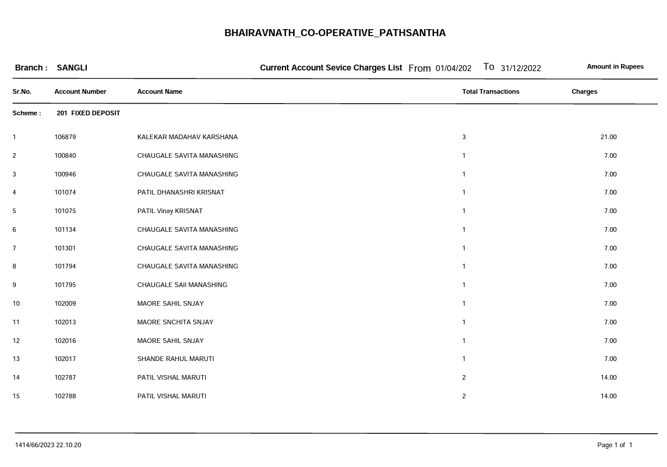
CHHATRAPATI SHAHU INSTITUTE OF BUSINESS EDUCATION & RESEARCH,KOLHAPUR
Report : 1) Service Charges List Report

Slide 6
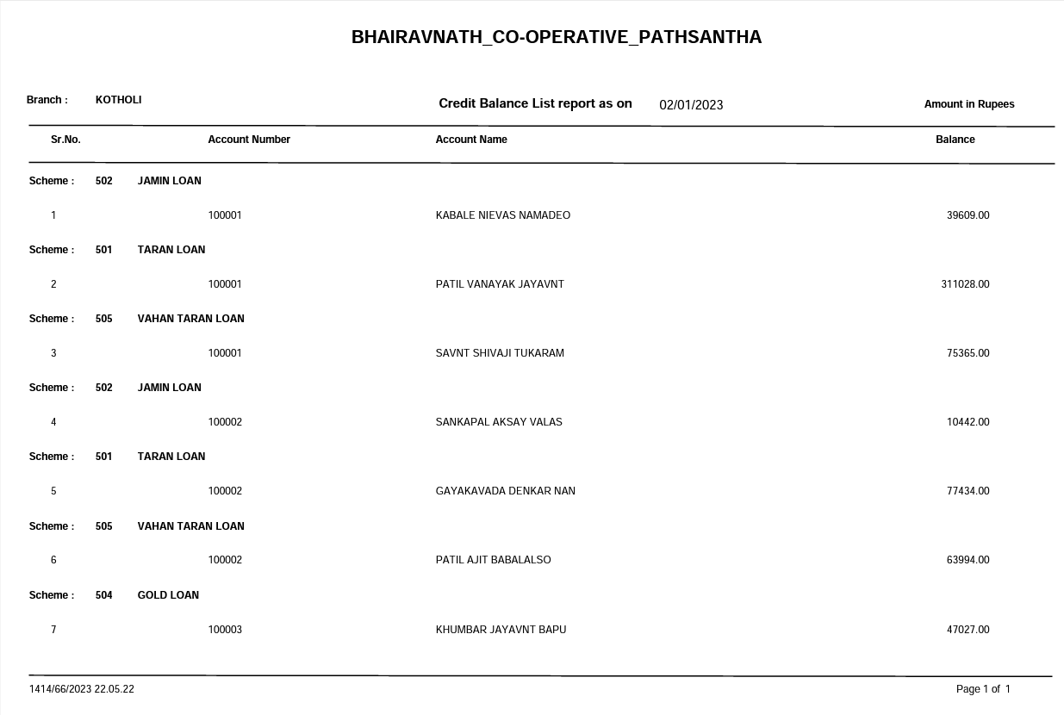
CHHATRAPATI SHAHU INSTITUTE OF BUSINESS EDUCATION & RESEARCH,KOLHAPUR
Report : 2) Credit Balance List Report

Slide 7
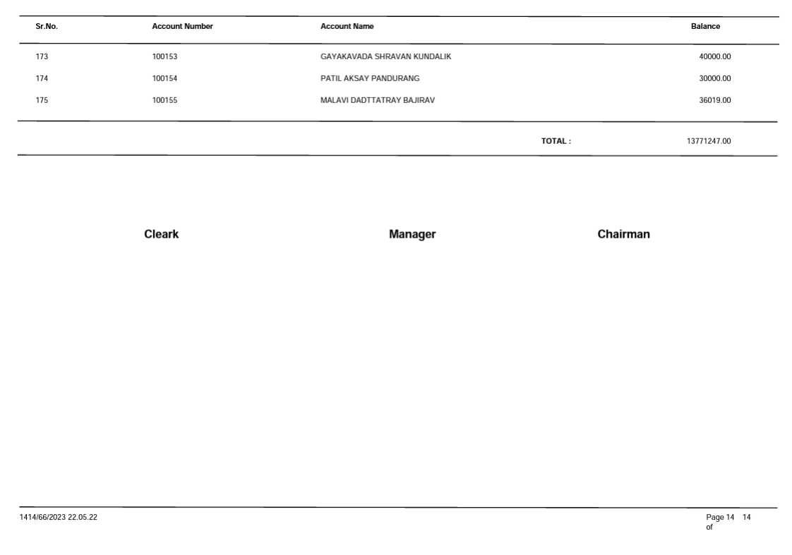
CHHATRAPATI SHAHU INSTITUTE OF BUSINESS EDUCATION & RESEARCH,KOLHAPUR
1) Credit Balance List Report

Slide 8
CHHATRAPATI SHAHU INSTITUTE OF BUSINESS EDUCATION & RESEARCH,KOLHAPUR
3) Module Information
Saving master is a module which consist all requirements related to open a saving account.
In this module there is a login page with username and password.
To save the data according to the type, there are several forms available like ,
Basic form
Address form
Nominee/Joint account form
Minor/Introducer details form
Document uploading form

Slide 9
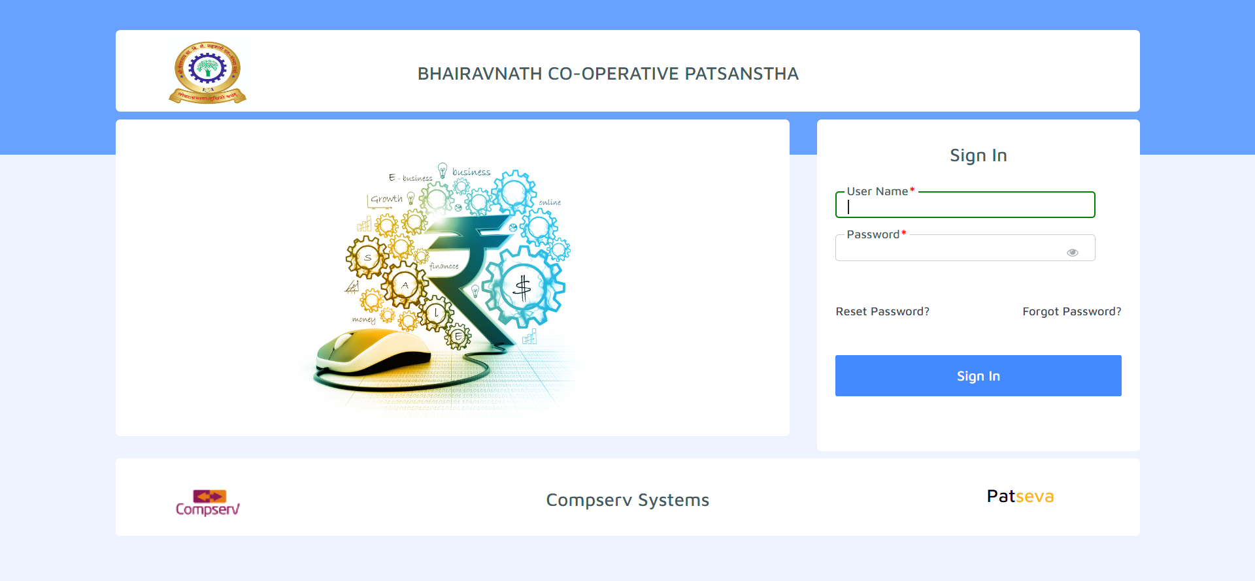
CHHATRAPATI SHAHU INSTITUTE OF BUSINESS EDUCATION & RESEARCH,KOLHAPUR
1.Login Form :
This form is used for getting valid credential from Banker.

Slide 10
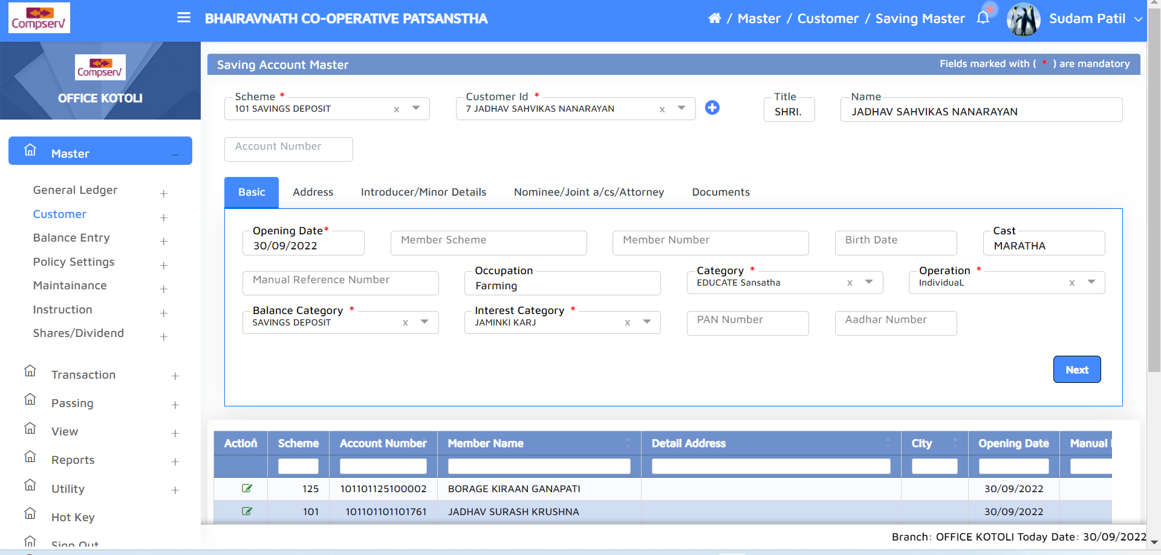
CHHATRAPATI SHAHU INSTITUTE OF BUSINESS EDUCATION & RESEARCH,KOLHAPUR
2.Basic Form :
This form consists basic information of customers like Aadhar number, PAN number, scheme details with opening date.

Slide 11
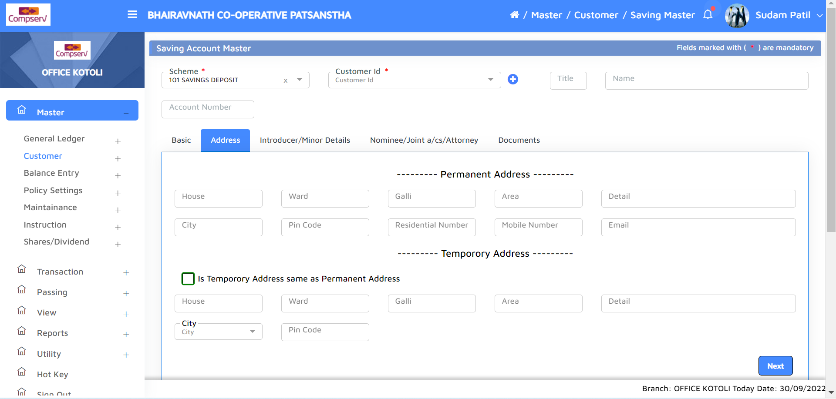
CHHATRAPATI SHAHU INSTITUTE OF BUSINESS EDUCATION & RESEARCH,KOLHAPUR
3.Address Form :
This form is used to store location of customer. If consists two parts one is Permanent address and second Temporary address.

Slide 12
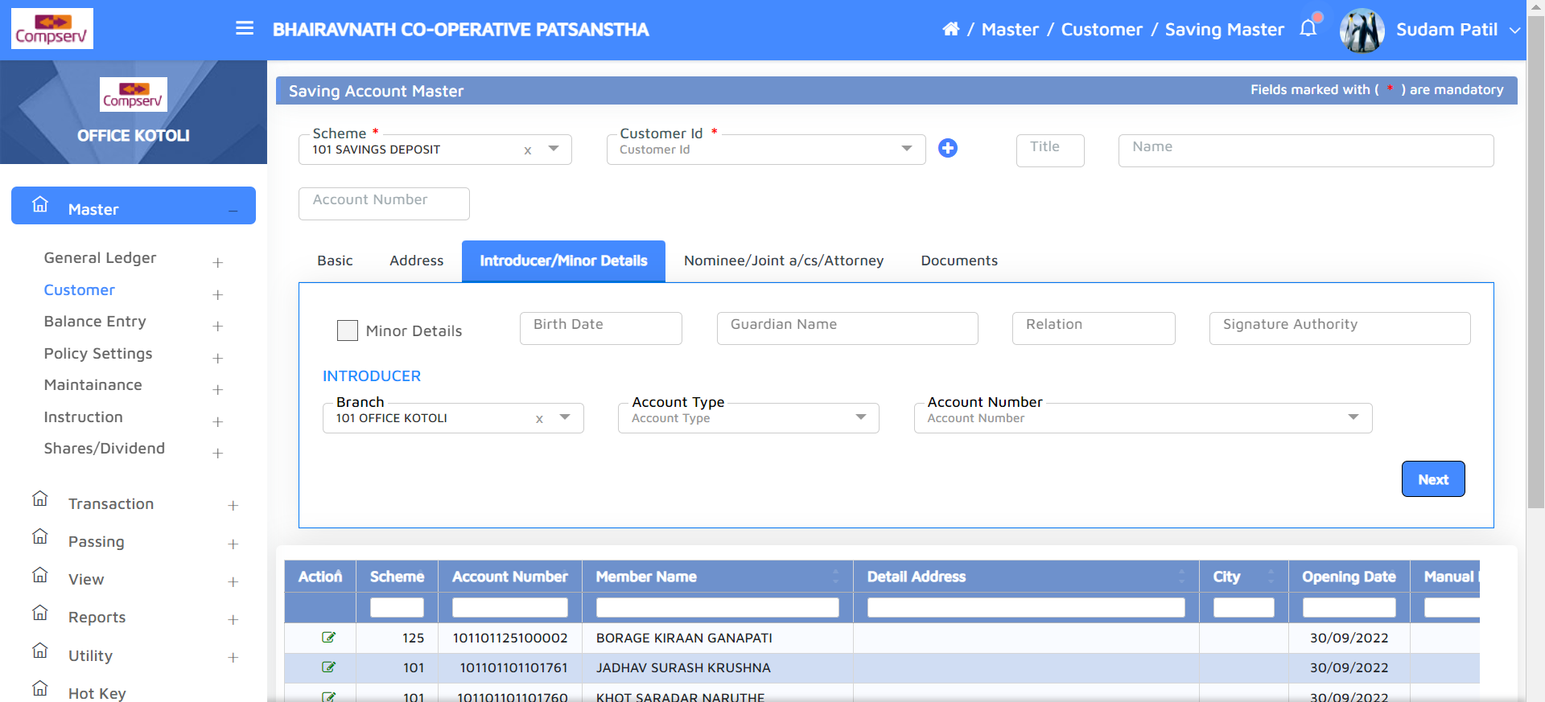
CHHATRAPATI SHAHU INSTITUTE OF BUSINESS EDUCATION & RESEARCH,KOLHAPUR
4.Introducer/Minor Details Form :
This form consist minor details of account holder. It consists birth date, signature authority and introducer.

Slide 13
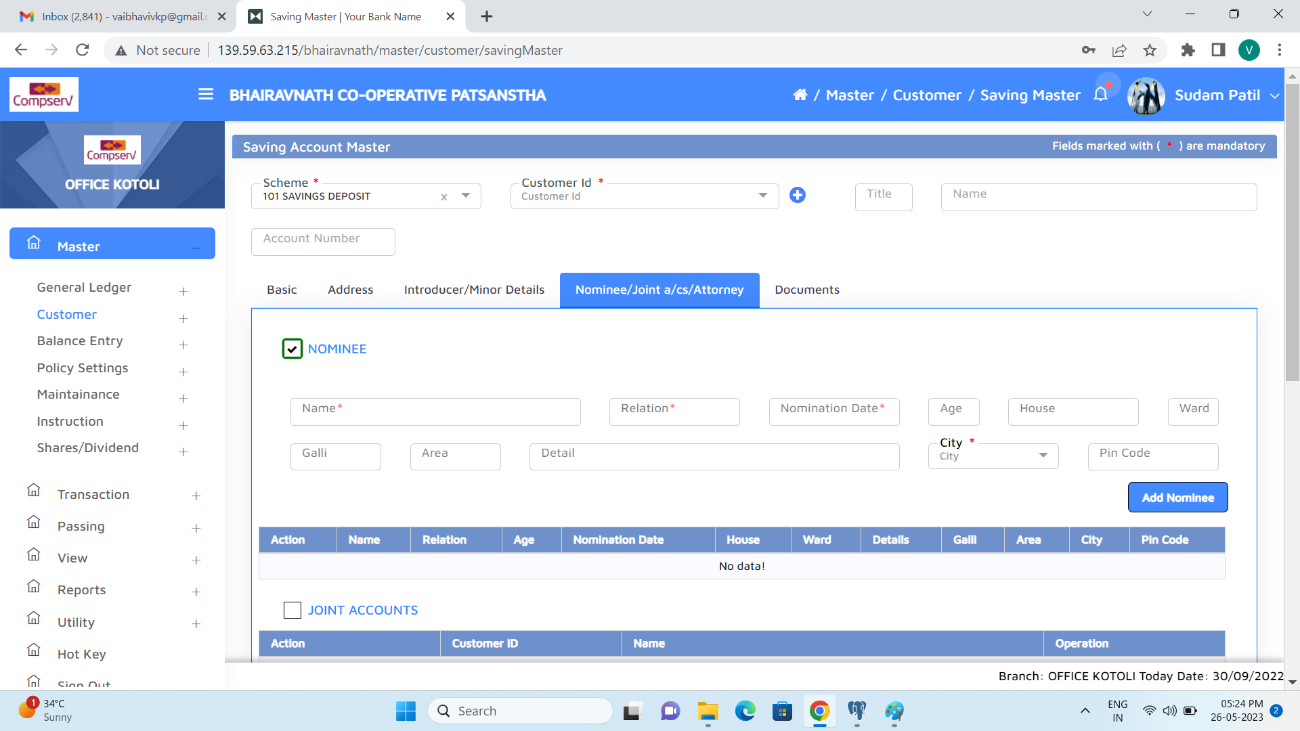
CHHATRAPATI SHAHU INSTITUTE OF BUSINESS EDUCATION & RESEARCH,KOLHAPUR
5.Nominee/Joint a/cs/Attroney Form :
Individuals need to mention nominee to handle account for back-up or in emergency case.

Slide 14
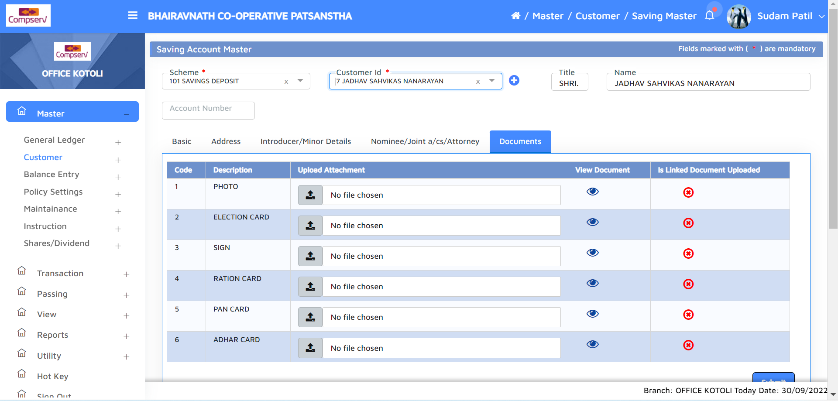
CHHATRAPATI SHAHU INSTITUTE OF BUSINESS EDUCATION & RESEARCH,KOLHAPUR
6.Document Uploading Form :
In this form banks can upload the soft copies, scan copies of documents needed to open the account.

Slide 15
CHHATRAPATI SHAHU INSTITUTE OF BUSINESS EDUCATION & RESEARCH,KOLHAPUR
4) Learned Skills
Knowledge about PHP.
Handle Jasper Report Tool.
Handle PostgreSQL Server.

Slide 16
CHHATRAPATI SHAHU INSTITUTE OF BUSINESS EDUCATION & RESEARCH,KOLHAPUR
5) Conclusion
I have acquired valuable knowledge about the banking sector.
The practical experience helped me to understand the intricacies of banking operations.
Collaborating with peers on tasks helped me to enhance communication skills , teamwork capability.
Got knowledge about the different departments , processes ,regulations , customer interactions.

